Slide 1
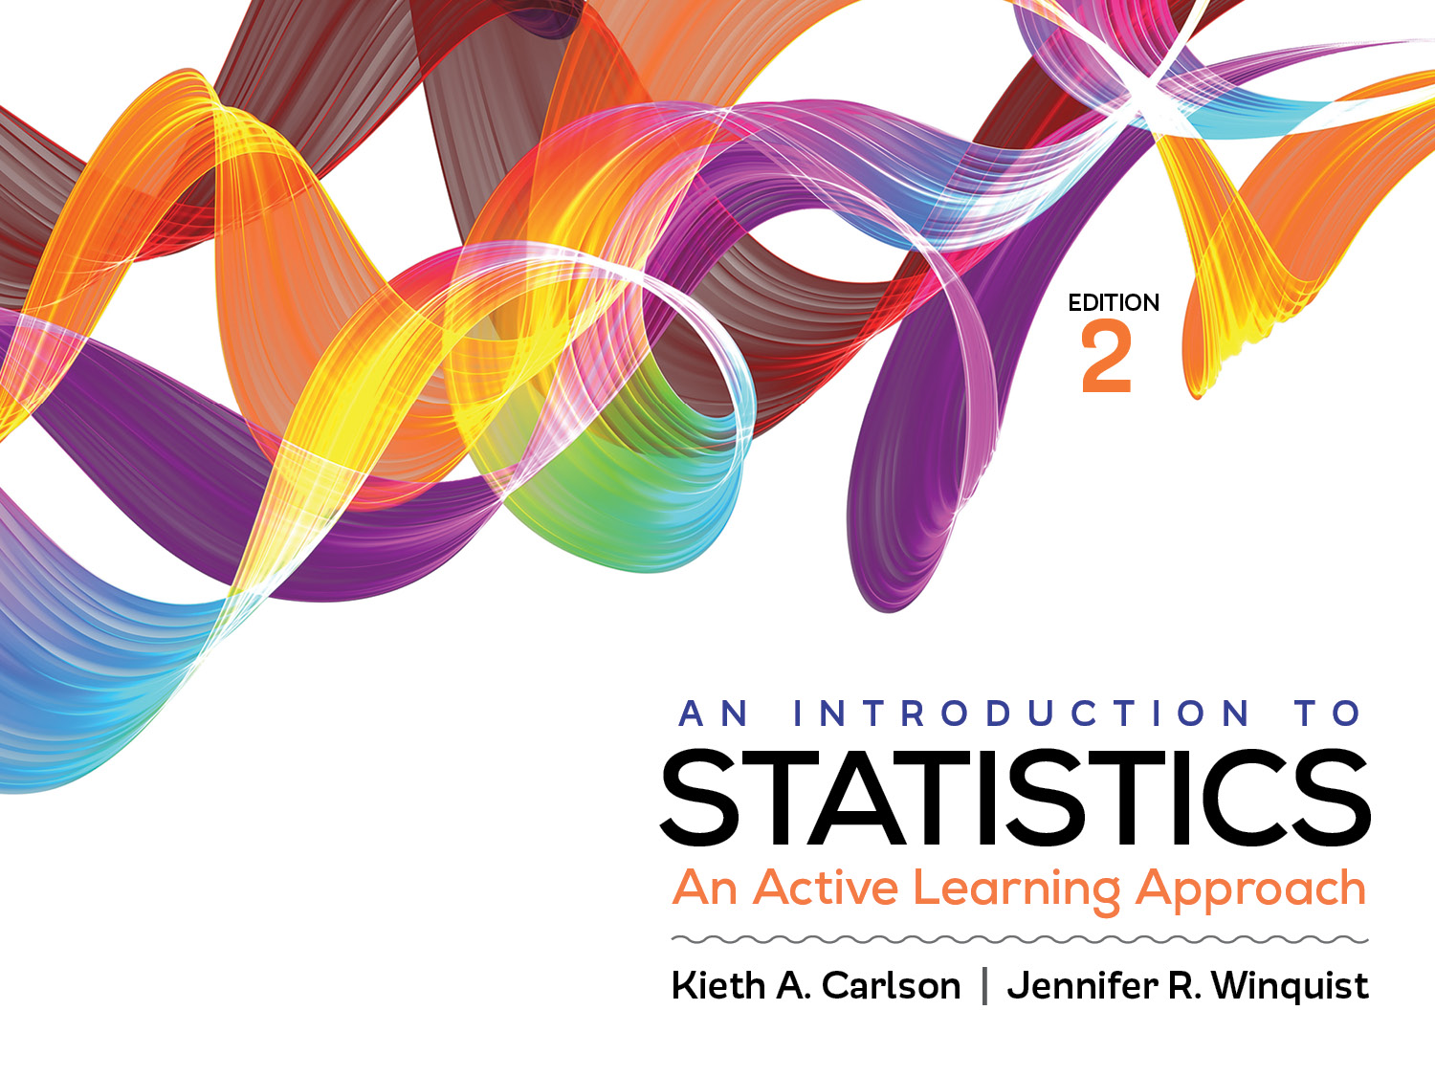
Introduction to Activity 8.1
Estimating sample means and sample mean differences

Slide 2
Activity 8.1 will require you to:
Summarize the key points of significance testing
Construct and interpret confidence intervals
Integrate confidence intervals into APS style summaries
Interpret SPSS output of confidence intervals

Slide 3
Purposes of statistical procedures
Statistical procedure | Purpose
Significance testing | Decide if a treatment worked Determine if result is likely due to sampling error
Effect size | Describe how well a treatment worked
Confidence interval | Estimate a population parameter

Slide 4
Confidence interval
Provides a range of plausible values for the population mean (or mean difference).
The upper bound (UB) is the highest plausible value for the population
The lower bound (LB) is the lowest plausible value for the population

Slide 5

Computing a confidence interval around a mean
from the t table
UB = sample mean + (critical t score)(SEM)
LB = sample mean − (critical t score)(SEM)
$${SD}/{\sqrt{N}}$$
Point estimate
Margin of error

Slide 6
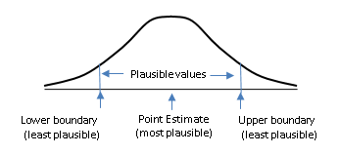
What do the UB and LB values represent?

Slide 7
Example
The mean score on a test of scientific knowledge for a sample of 50 college graduates is M = 68.3 (SD = 12.4). Compute a 95% confidence interval around the mean.
Point estimate = 68.3
Margin of error = (critical t)(SEM) = (2.0096)(12.4/√50) = 3.52
LB = point estimate – margin of error = 68.3−3.52 = 64.78
UB = point estimate + margin of error = 68.3+3.52 = 71.82
From the two-tailed t table with α = .05
Notes:
A very common mistake that students make is to compute the obtained t and use that in the CI formula. Stress that the critical t comes from the Appendix. It is NOT calculated. The activity will explain why.

Slide 8
Interpretation of confidence intervals
95% (or 99%) confident that the true mean for the population of college graduates on the scientific knowledge test falls between 64.78 and 71.82
Plausibility of values actually being the population parameter
The point estimate is the most plausible value (i.e., best guess)
The further values are from the point estimate, the less plausible they are
Of all the values in the CI, the UB and LB are the least plausible
Values outside the CI are still possible but considered not likely

Slide 9
95% vs 99%
The more confident you want to be, the wider the interval has to be
Think of it this way…..
Here are two confidence intervals for estimating my age.
30–70 or 43–45; You should be more confident that the wider interval contains my age than the smaller interval.

Slide 10
Confidence interval around mean difference
Same procedure, only the point estimate changes
UB = sample mean difference + (critical t score)(SEM)
LB = sample mean difference − (critical t score)(SEM)
Point estimate
(M−µ)
Margin of error

